Slide 1
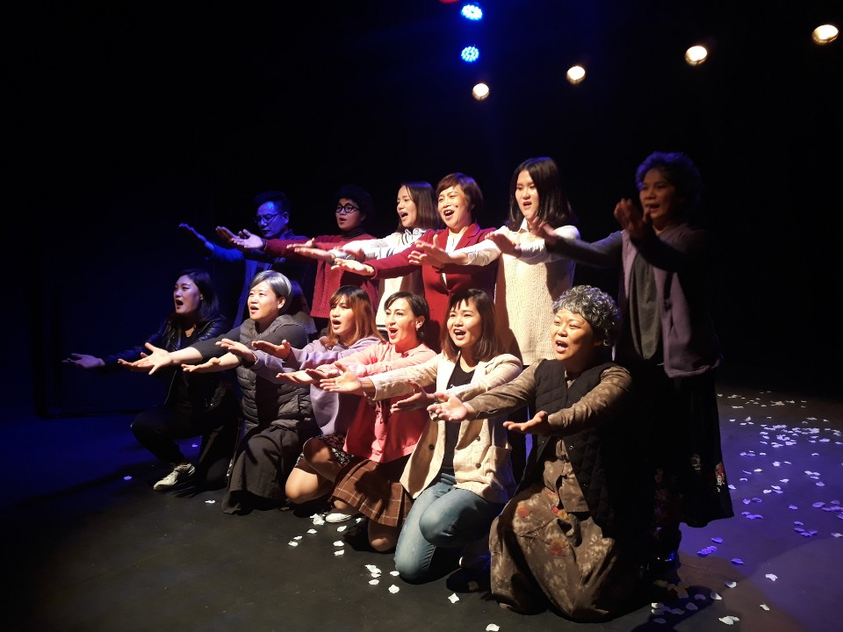
We are looking for a family to join as a
member of the Damanse Theater.♥
We are looking for a member of the multicultural theater group with the Suseong-gu Healthy Family and Multicultural Family Support Center in 2020. Through “Play-acting” we are looking for a main character who will have the opportunity to self-express and communicate and to be a member of the Damanse theaters who can communicate and inform various cultures to the community.
Target ｜Marriage immigrant in the area and local family
※Those who are interested in theater and have good communication
Training schedule ｜ 2020. 1 year course (Schedule every Tue/Fri pm)
Venue ｜ Center Classroom(대구 수성구 들안로 16길 78)
Application｜ Visit or call 053-764-4317
Supported by: Daegu Social Welfare Community Chest
Organized by: Suseong-gu Healthy Family and Multicultural Family Support Center

